Slide 1





Slide 2

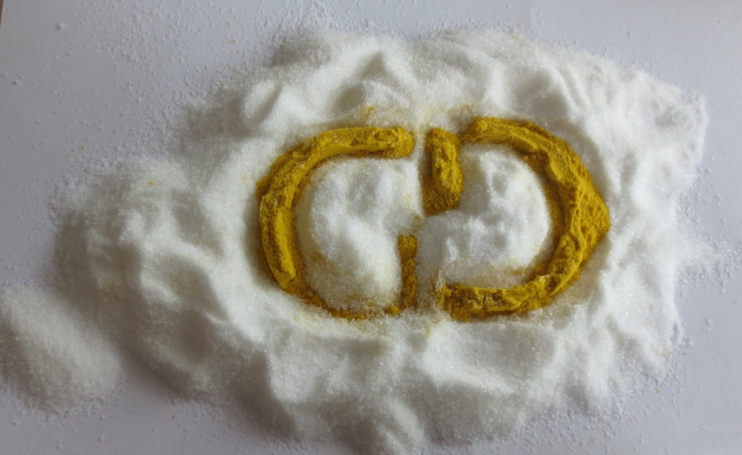


General Dosing is a company that has significant experience, since 1985, in the field of dosing and more in general in the management of raw materials.
THE MISSION
The mission of the company
is to offer and provide to the
manufacturing industries the
widest range of technical
solutions for the raw material
management.

Slide 3
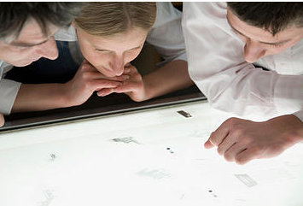
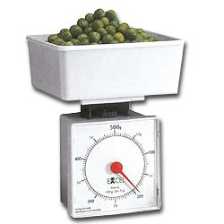
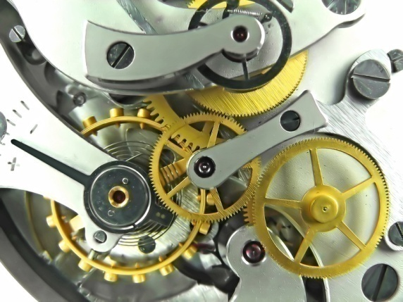
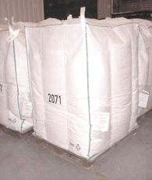
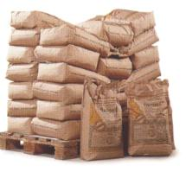
ABOUT US
The company is constituted by a group of technicians,
Some of them with over 30 years of experience in
the field,responsible for the study and implementation
of sometimes, very customized solutions for the customer.
The main issues addressed are: assay both volumetric
and gravimetric and to weighing processes industrial in general.
The orders concern the design and
the supply of both stand-alone machines
and fully integrated systems to processes
of raw materials transformation.
Pneumatic conveying systems can be
also be supplied as a refilling unit for dosing machines and
also other complete systems such as intermediate storage
hoppers and emptying and filling big-bag stations.

Slide 4

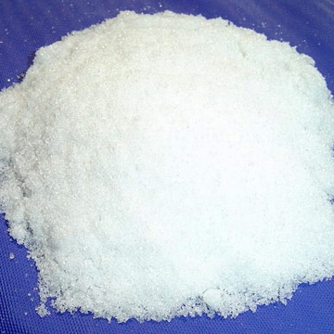



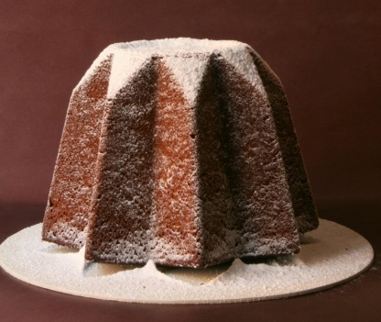

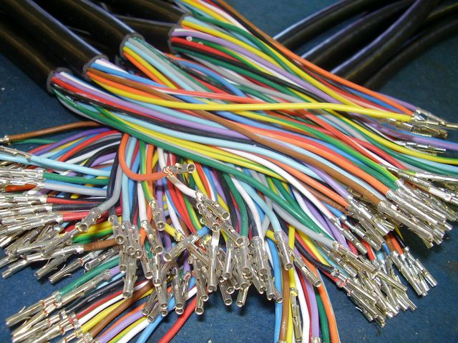



Powder and granular products are normally treated but also liquids and fluids in general.
The most significant experience has been gained in the food industry, the chemical industry in general and the extrusion of plastics.

Slide 5



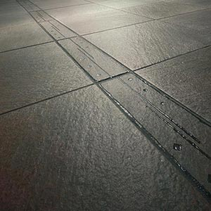

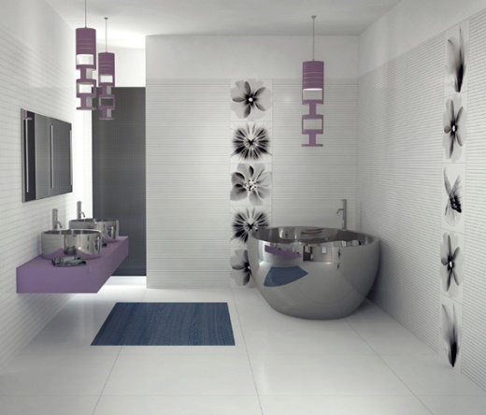
Projects of considerable importance, both in terms of size and technological contents, have been completed in the field of domestic hygene products, for the production of biologic and functional foods and for breakfast.
Innovative dosing systems have been developped also for the ceramic sector.

Slide 6




OUR MAIN MARKETS
FOOD INDUSTRY
CHEMICAL INDUSTRY
CERAMIC CONSTRUCTION
PLASTIC INDUSTRY

Slide 7
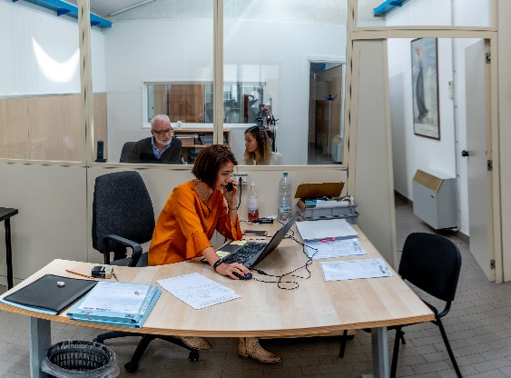
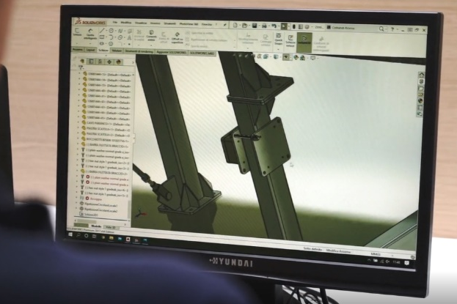

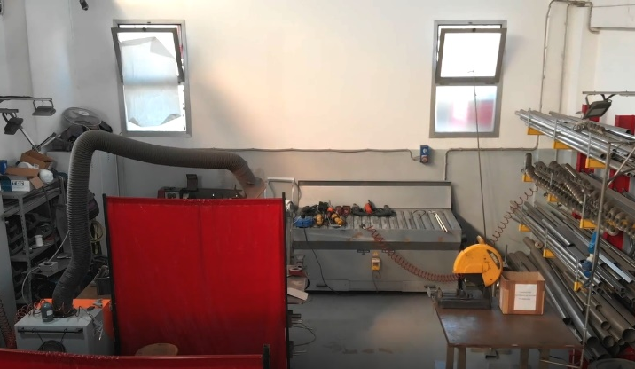
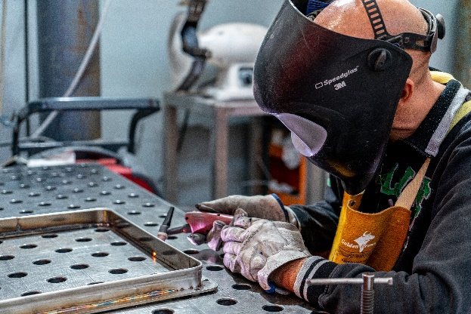
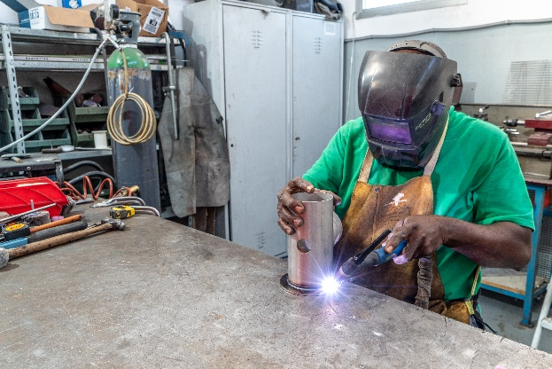
The company is located in Modena and is basically configured as a technical office of mechanical and electrical design with a warehouse and production area. The production consists in three departments dedicated to welding, mechanical assembly and electric machine edge.

Slide 8
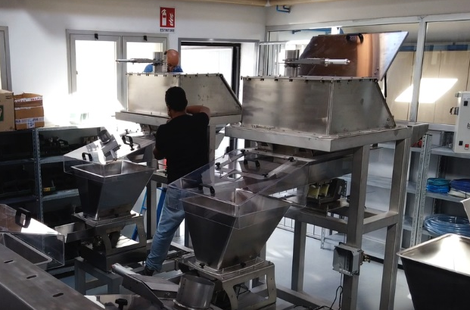
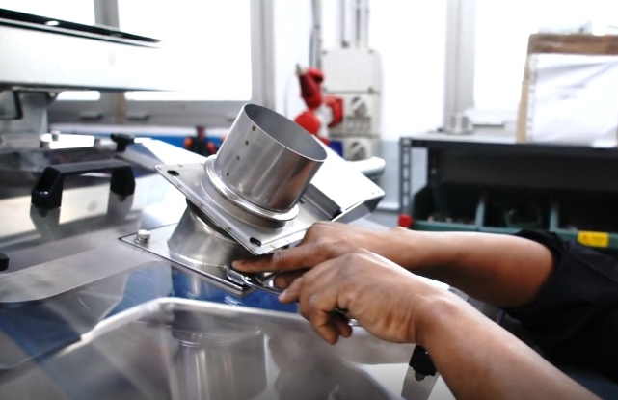
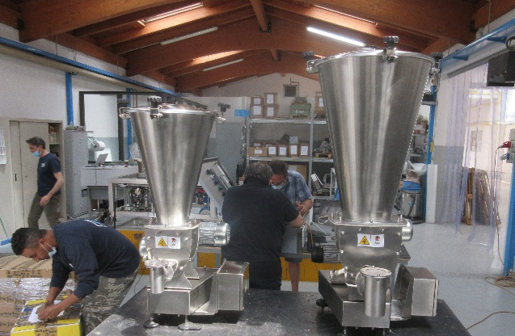
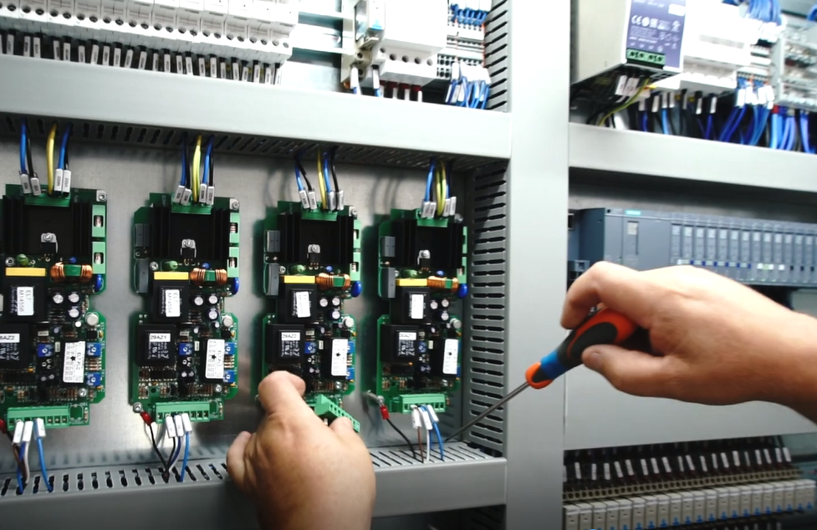
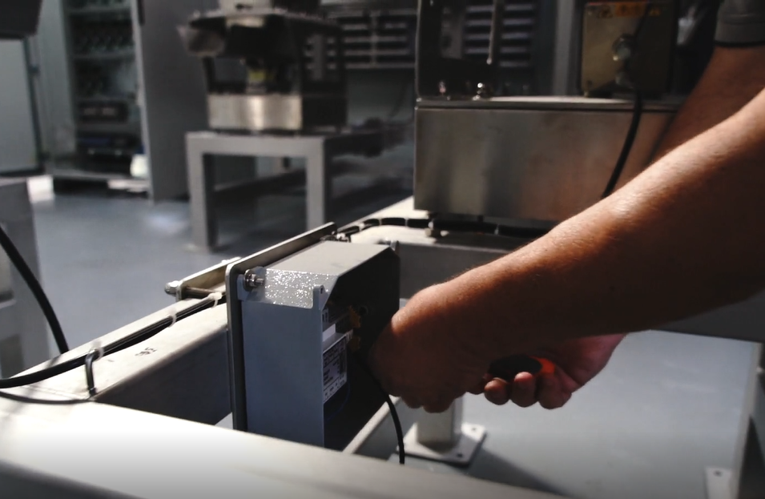
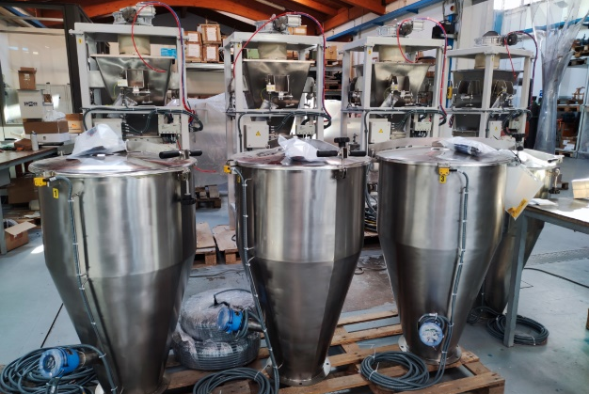

Slide 9



THE ORGANIZATION
- General Direction: Francesco Famà
In particular, he serves as Technical Sales Manager.
He defines fisrt-hand the technical choices underlying the sales proposals and participates in the development of projects of major importance.
- Marketing Department: Viola Famà
She deals with finding new customers and new market segments.
- Credit Manager and Controller: Elisabetta Famà
She monitors the progress of contracts with relative economic and financial reporting. She manages the treasury and the banking relationships.

Slide 10
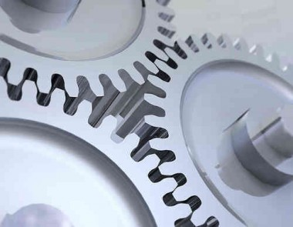
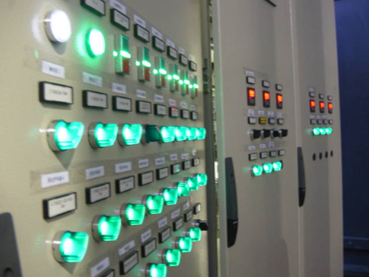
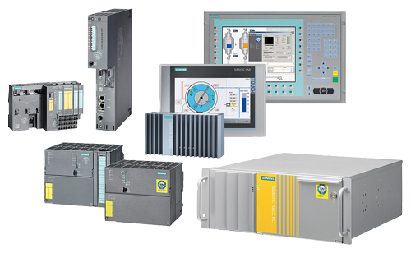
THE ORGANIZATION
- Mechanical technical department: Gabriele Bernardoni
He develops technically the production orders, produces constructive drawings, takes care of purchases and follows the logistics of mechanical materials and carpentry. He participates with the General Direction in the research and development of new machines and systems.
Technical electric department: Giuseppe Macrì
He deals with electrical design and automation defining the specifications of the plant and providing the purchase of electrical and electronic contract details. He also deals with laboratory tests, coordinates and participates actively in the phases of testing and start-up at customers.
Automation and Software Office : Simone Pellacani
He develops control software on PLC and pc based on the order specifications. He also designs supervision, data collection and sharing software for Industry 4.0.

Slide 11
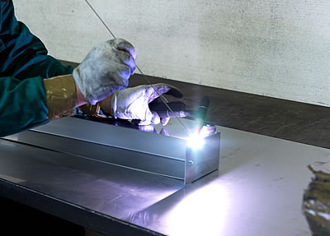
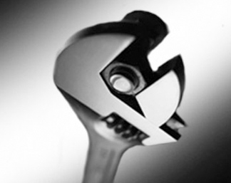
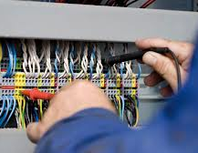
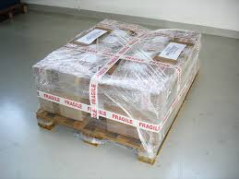
THE PRODUCTIVE ACTIVITIES
Domestic production covers the following activities:
- Welding of stainless steel carpentry parts, passivation and surface
finish.
- Mechanical assembly of semi-finished products
and finished machines.
- Equipment of both electric and pneumatic
machine edge.
- Final testing and testing of the machines.
- Packing and shipping.
Laser cutting machining, bending, calendering and
perforation to design of the carpentry are commissioned to
external suppliers, as well as mechanical machining on automatic machines. Also the wiring of electrical panels, as well as the possible realization of electrical systems at the customer, is carried out by external suppliers on project General Dosing.

Slide 12
PRODUCT PORTFOLIO
Dosing and Blending:
Single and double screw dosers for powders
Vibratory channel or pipe dosers
Weigh belts and weigh feeders
Multi-ingredients dosing stations
Semi-automatic bench-top filling machines
Dosing machines for automatic filling lines
Stationary and mobile weighing hoppers with load cells
Mixing hoppers
Tumbler aromatization system
Semi-automatic weigh filling machines
Dosers for liquids
Dissolevers
Side feeders and vertical force feeders for extruders
Dosers for plastic granules
Multi zone dosing stations for plastics
Gravimetric blenders for plastics

Slide 13
PRODUCT PORTFOLIO
Management of
bulk products
- Pneumatic loaders
Vacuum threephase units for pneumatic transport
Product intake hopper for pneumatic transport
Flat bottom extractors and flat extracting hoppers
Bags emptying stations
Big-bag emptying stations
Big-bag filling stations
Automation and control
process
- Electric panels
Plc , Measuring and control devices
Software for automation and Supervision

Slide 14
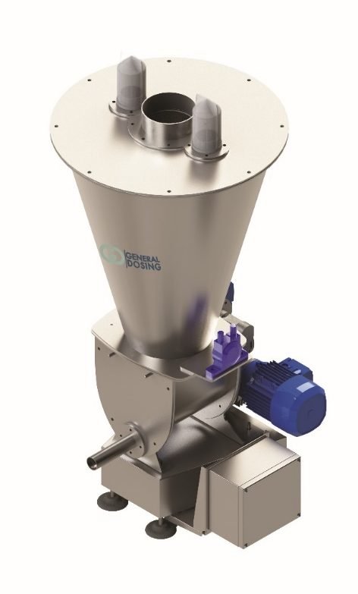
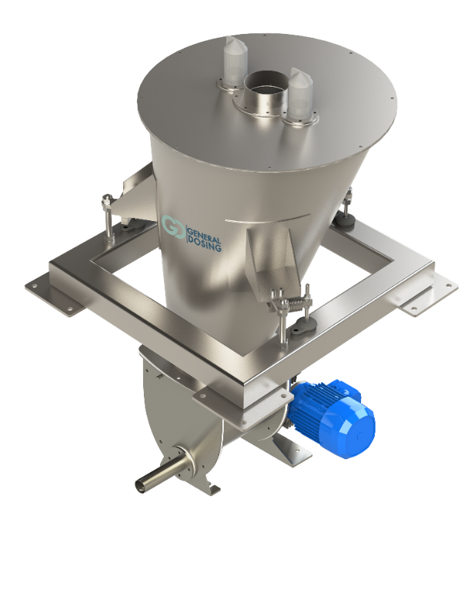
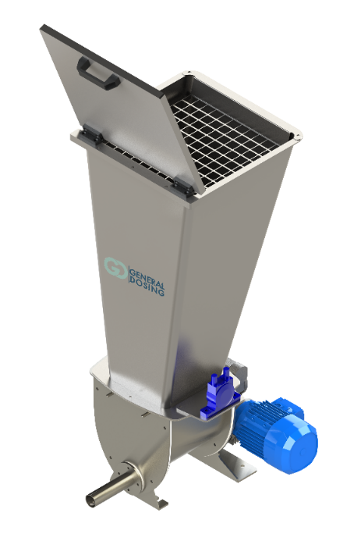
PRODUCT PORTFOLIO
Single and double screw dosers for powders
Dosing and blending
Gravimetric hanging on load cells
Volumetric
Gravimetric on scale

Slide 15
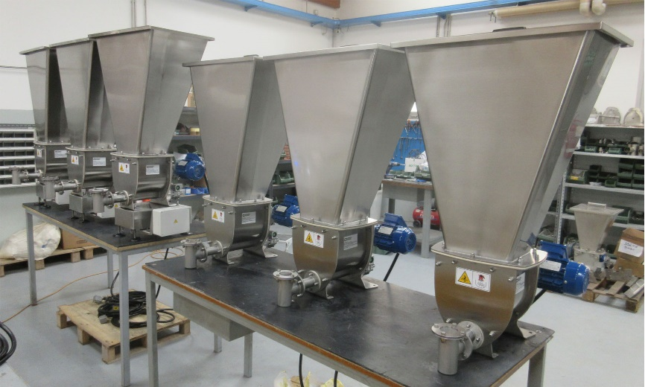
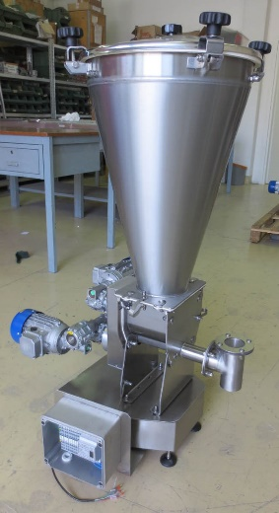
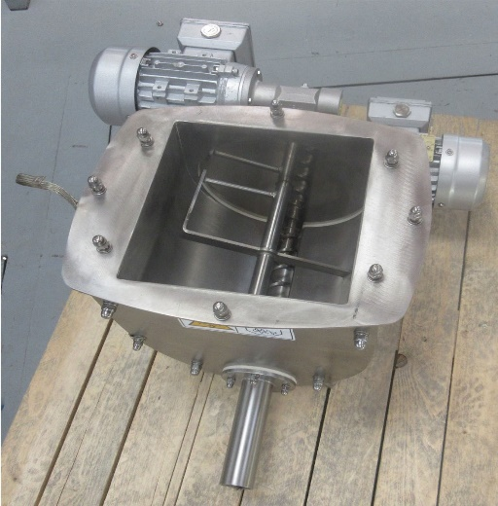
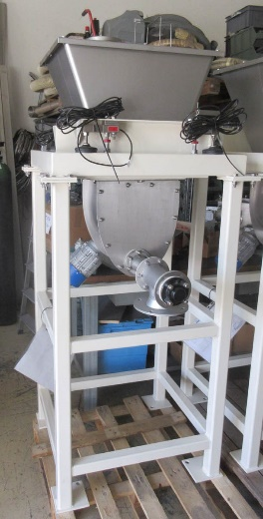
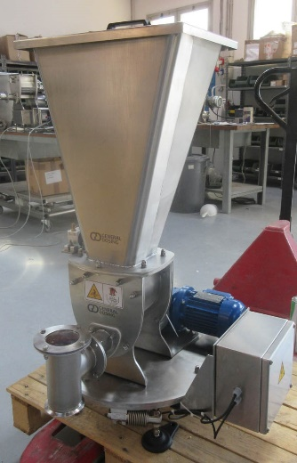
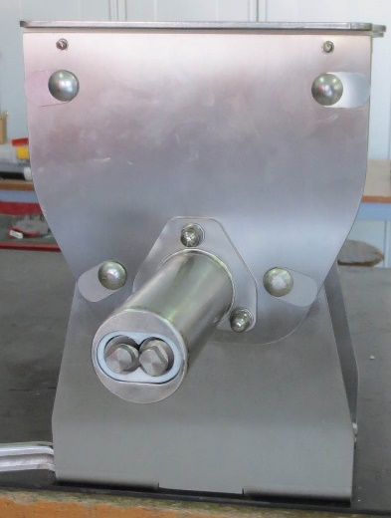
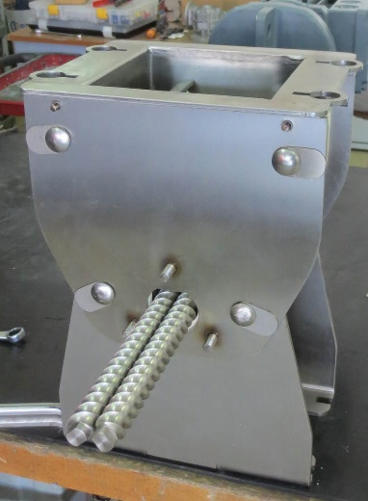
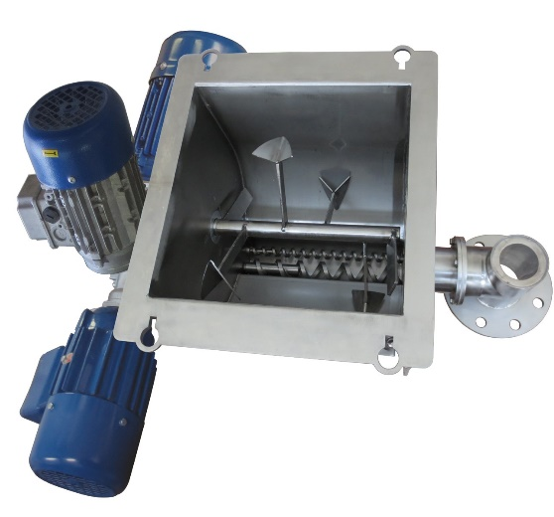
PRODUCT PORTFOLIO
Single and double screw dosers for powders
Dosing and blending

Slide 16
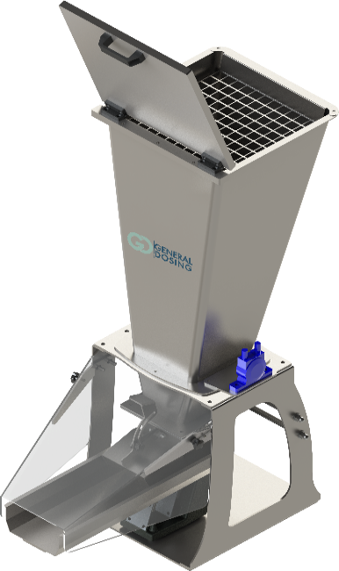
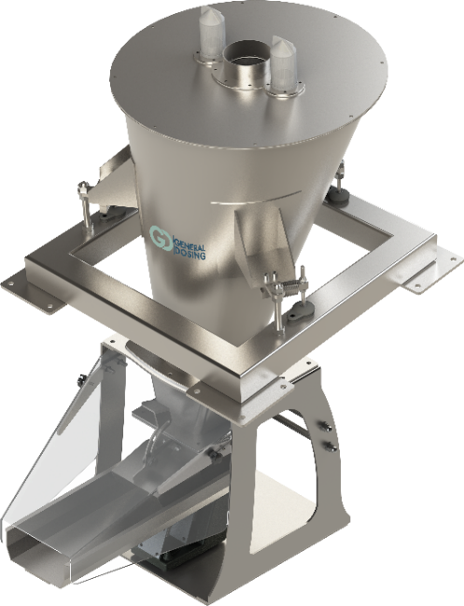
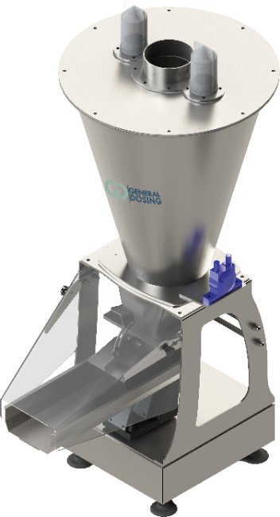
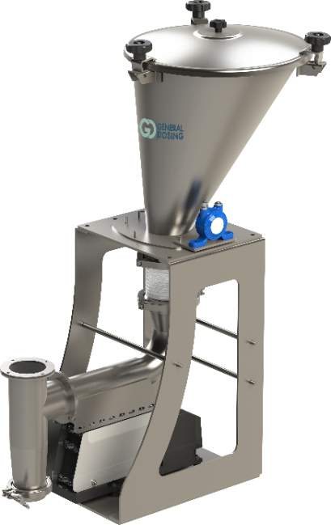
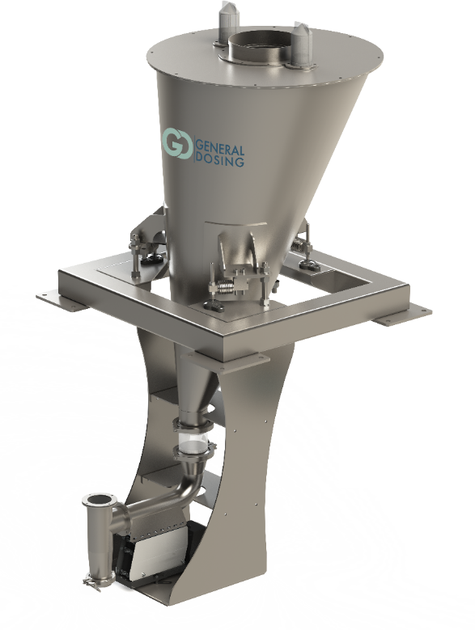
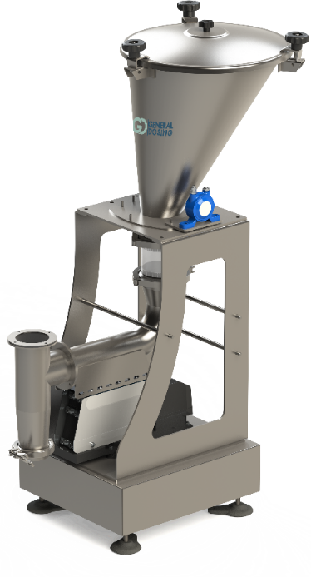
PRODUCT PORTFOLIO
Vibrating channel or pipe dosers
Dosing and blending
Volumetric
Gravimetric on scale
Gravimetric hanging on load cells

Slide 17
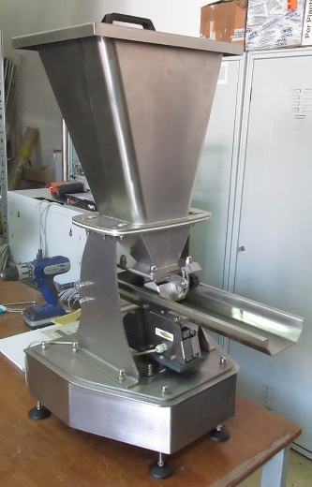
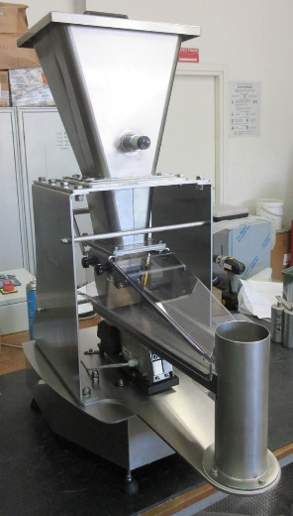
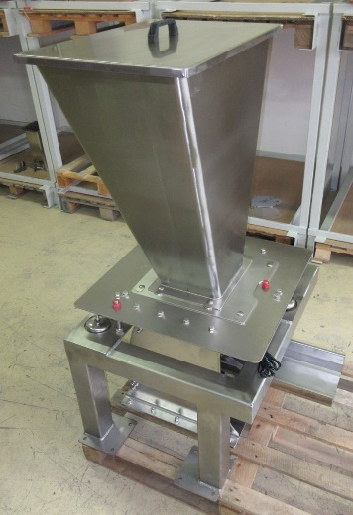
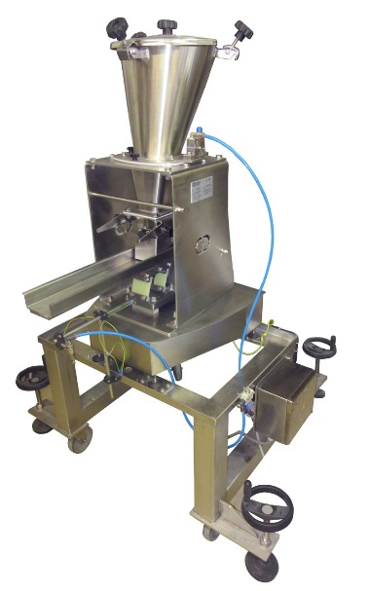





PRODUCT PORTFOLIO
Vibrating channel or pipe dosers
Dosing and blending

Slide 18



PRODUCT PORTFOLIO
Weighing belts and belt dosers
Dosing and blending

Slide 19







PRODUCT PORTFOLIO
Multi-ingredients dosing stations
Dosing and blending
With fixed scale
With dosers on scale
With mobile scale

Slide 20




PRODUCT PORTFOLIO
Semi-automatic bench-top filling machines
with screw or vibrating channel dosers
Dosing and blending
Gravimetric on scale
With barbell discharge
With outer scale

Slide 21









PRODUCT PORTFOLIO
Semi-automatic bench-top filling machines
with screw or vibrating channel dosers
Dosing and blending

Slide 22



PRODUCT PORTFOLIO
Dosing machines for automatic filling lines
Dosing and blending
Volumetric in time or in pieces
Gravimetric on scale
Gravimetric with barbell discharge

Slide 23





PRODUCT PORTFOLIO
Dosing machines for automatic filling lines
Dosing and blending

Slide 24




PRODUCT PORTFOLIO
Dosing and blending
Stationary and mobile weighing hoppers with load cells
Static scale on fixed structure
Motorized scale on rails

Slide 25





PRODUCT PORTFOLIO
Mixing hoppers
Dosing and blending
Volumetric
Gravimetric on load cells

Slide 26






PRODUCT PORTFOLIO
Tumbler aromatization systems
Dosing and blending
With gravimetric doser flavours

Slide 27



PRODUCT PORTFOLIO
Semi-automatic weigh bagging stations
Dosing and blending
Bag support on load cells

Slide 28



PRODUCT PORTFOLIO
Dosers for liquids
Dosing and blending
Gravimetric hanging on lead cells
Volumetric
Gravimetric on scale

Slide 29









PRODUCT PORTFOLIO
Dosers for liquids
Dosing and blending

Slide 30




PRODUCT PORTFOLIO
Dissolvers
Dosing and blending
Volumetric
Gravimetric hung on load cells

Slide 31



PRODUCT PORTFOLIO
Side feeders and vertical force feeders for extruders
Dosing and blending
Side feeder
Vertical force feeder

Slide 32











PRODUCT PORTFOLIO
Side feeders and vertical force feeders for extruders
Dosing and blending

Slide 33






PRODUCT PORTFOLIO
Dosers for plastic granules
Dosing and blending
Volumetric
Gravimetric hung on load cells

Slide 34






PRODUCT PORTFOLIO
Dosing and blending
Multi-zone dosing station for plastics
With volumetric dosers with vertical mixer
With gravimetric dosers hung on load cells

Slide 35






PRODUCT PORTFOLIO
Dosing and blending
Gravimetric blenders for plastics

Slide 36

PRODUCT PORTFOLIO
Pneumatic chargers
Bulk handling
Gravimetric on load cells
Three
phase
With vacuum generator
Continuous cycle

Slide 37






PRODUCT PORTFOLIO
Pneumatic charger
Bulk handling

Slide 38


PRODUCT PORTFOLIO
Bulk handling
Threephase suction unit for pneumatic transport
With centrifugal pump
With lobe or vane pump

Slide 39







PRODUCT PORTFOLIO
Bulk handling
Threephase suction unit for pneumatic transport

Slide 40


PRODUCT PORTFOLIO
Bulk handling
Product intake hoppers for pneumatic transport
Basic model
Gravimetric version with base on load cells
Gravimetric version hung on load cells

Slide 41







PRODUCT PORTFOLIO
Bulk handling
Product intake hoppers for pneumatic transport

Slide 42





PRODUCT PORTFOLIO
Bulk handling
Flat bottom extractor and extracting hoppers
Flat bottom extractor
Flat bottom hopper

Slide 43

PRODUCT PORTFOLIO
Bulk handling
Bags emptying stations
Basic model
Version with cabin
Version with extractor hood and integrated filter

Slide 44








PRODUCT PORTFOLIO
Bulk handling
Bags emptying stations

Slide 45



PRODUCT PORTFOLIO
Bulk handling
Big-bag emptying stations
Basic model
Gravimetric version on load cells
Versions with integrated lifting hoist

Slide 46








PRODUCT PORTFOLIO
Bulk handling
Big-bag emptying stations

Slide 47

PRODUCT PORTFOLIO
Big-bag filling stations
Bulk handling
Gravimetric version on load cells
Basic model

Slide 48




PRODUCT PORTFOLIO
Big-bag filling stations
Bulk handling

Slide 49

PRODUCT PORTFOLIO
Automation and control process
Typical architecture for data control and exchange

Slide 50







PRODUCT PORTFOLIO
Automation and control process
Electric panels, Hardware and Software

Slide 51


























SOME OF OUR REFERENCES
Confidential document

Slide 52




GENERAL DOSING PARTNERS IN THE WORLD
Leadbulk AB (Org.nr. 556979-6492)
Plastgatan 6, 531 55 Lidköping
info@leadbulk.se
0510 59 00 59
AREA : DENMARK/SWEDEN
Quinta Figueira Armz 1-F 2615-711
SOBRALINHO Portugal
E :commercial@gegmi.pt
W: www.gegmi.pt
Tel. 218494471
AREA : PORTUGAL
Euteos Ltd
Elyashiv St 2, Petah Tikva, Israele
T :+972 3 9080706
E: eli@Euteos.com
W: www.Euteos.com
AREA : ISRAEL

Slide 53
Headquarter: Via V. Alfieri, 59
41124 Modena - Italy
Tel. +39 059 7100567 Fax. +39 059 6138149
E-mail: generaldosing@generaldosing.com
http: www.generaldosing.com

