Slide 1
MixSing program

Slide 2



TPS team
MANAGEMENT
TPS Founders & Owners
Claus Siegaard, CEO
M.Sc Dairy Technology & Science
30+ years of Industry experience
Erik Harbo, EVP & MD
M.Sc Dairy Technology & Science
30+ years of Industry experience
Advisory Board member
Kasper J. H. Ditlevsen
MBA
20+ years of experience

Slide 3
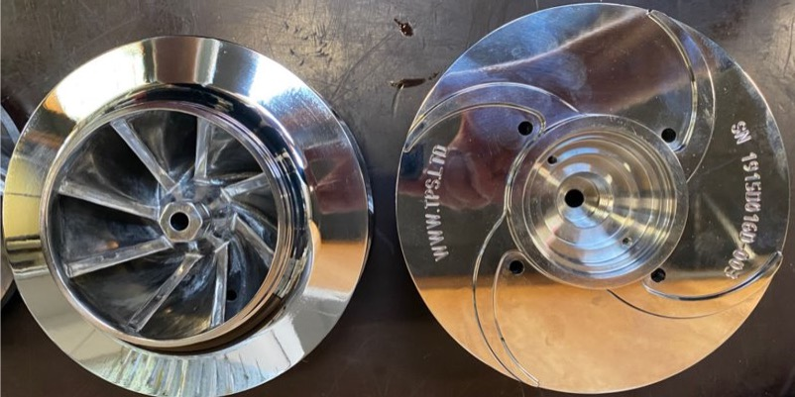
MixSing key technology
Developed in Denmark with external specialist
Tested for noise, particle distribution, NSPH, power consumption etc.
Own casting molds for
  Impeller
  Stator
  Console
  Flange
Picture: development model

Slide 4
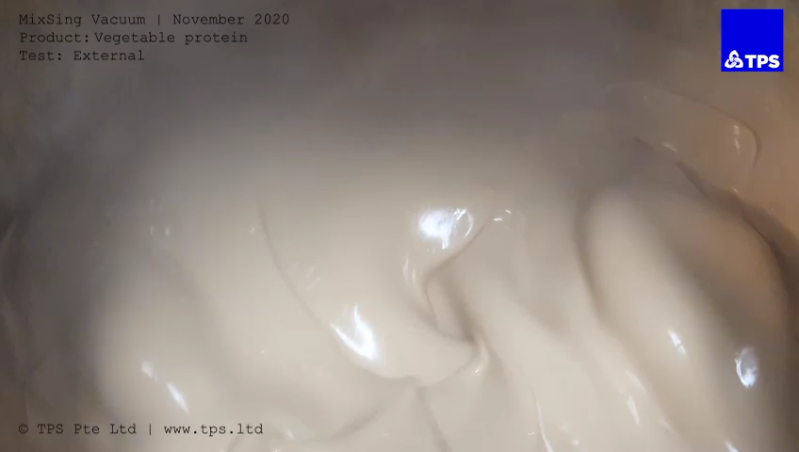

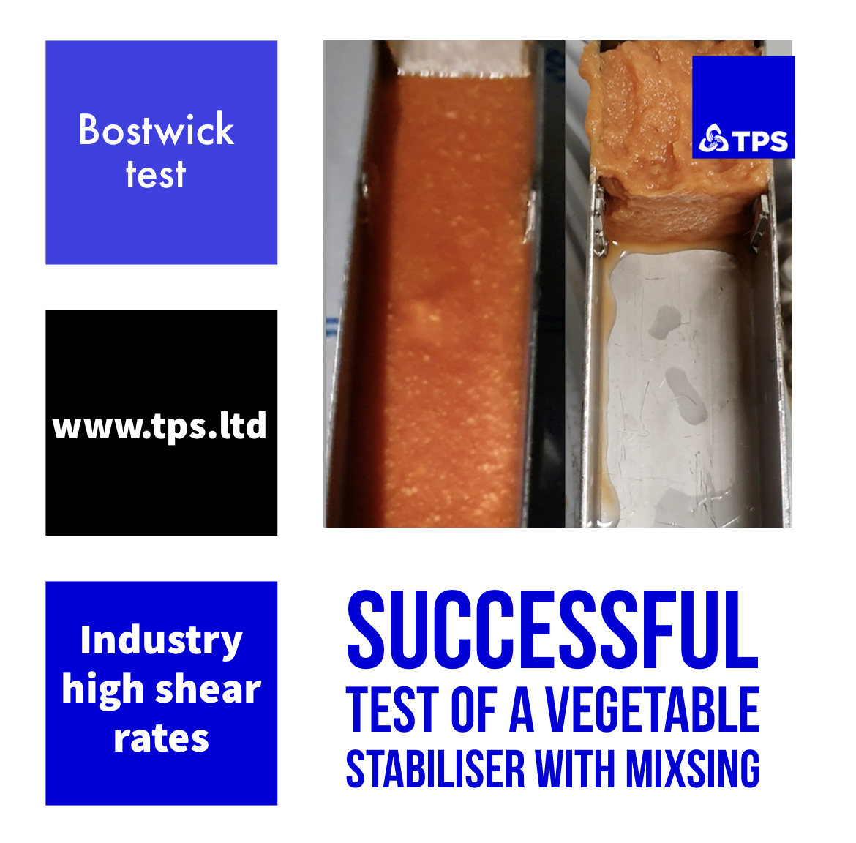
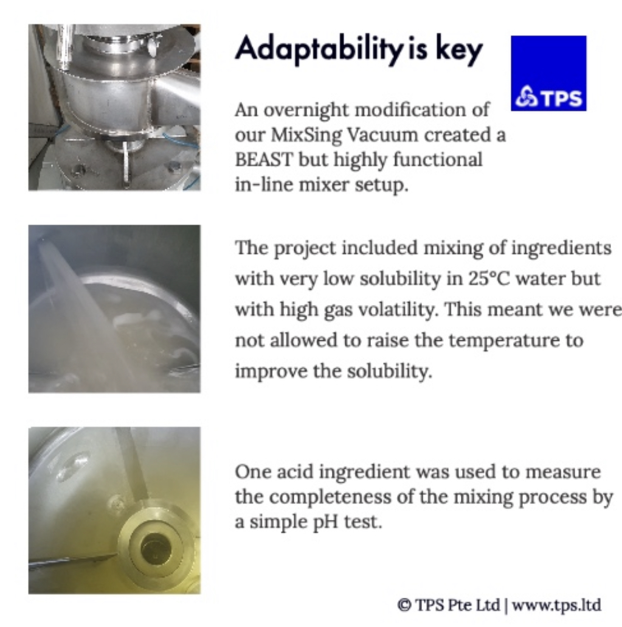
MixSing | Client tests

Slide 5
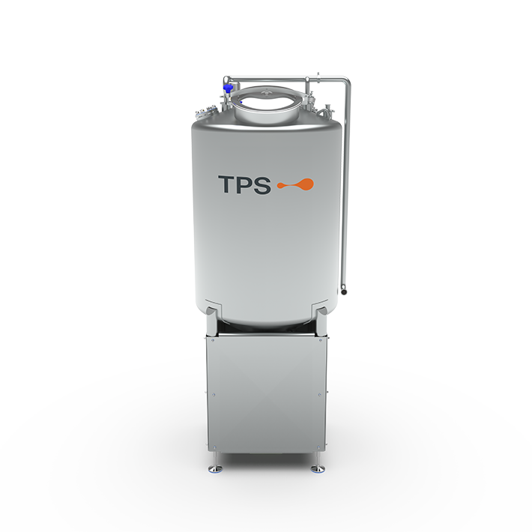
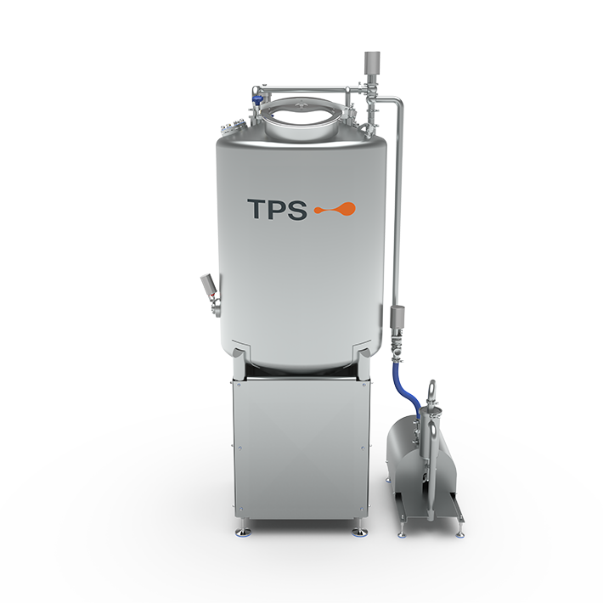
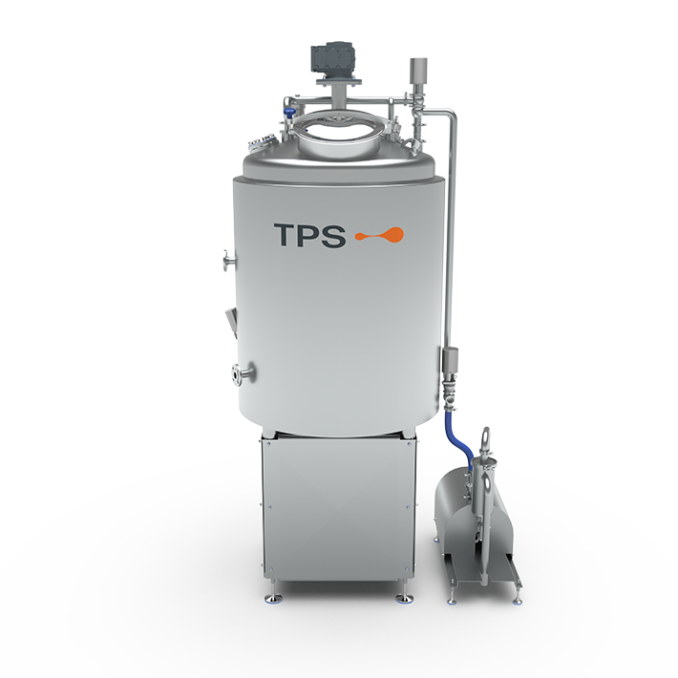
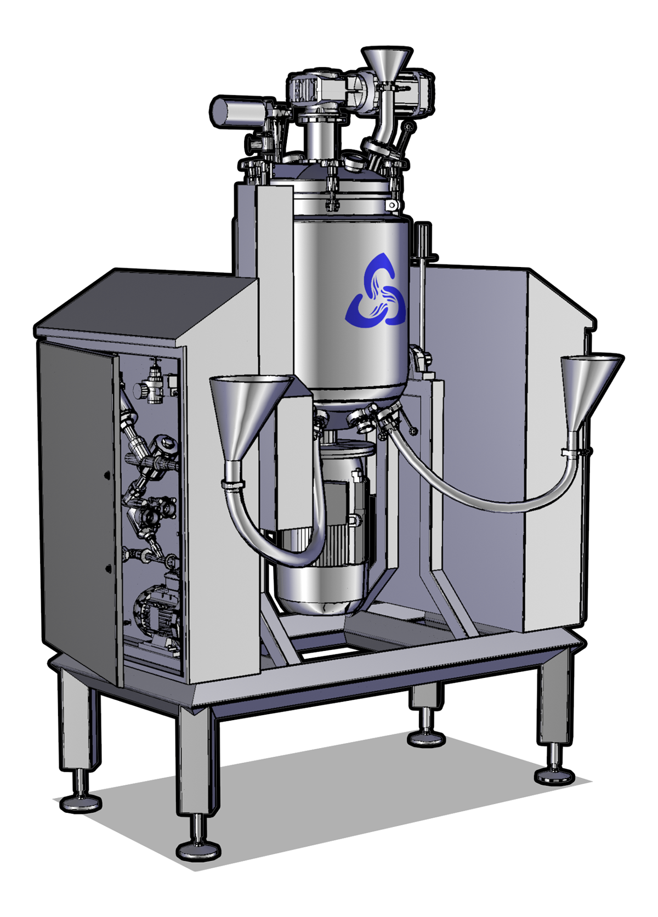
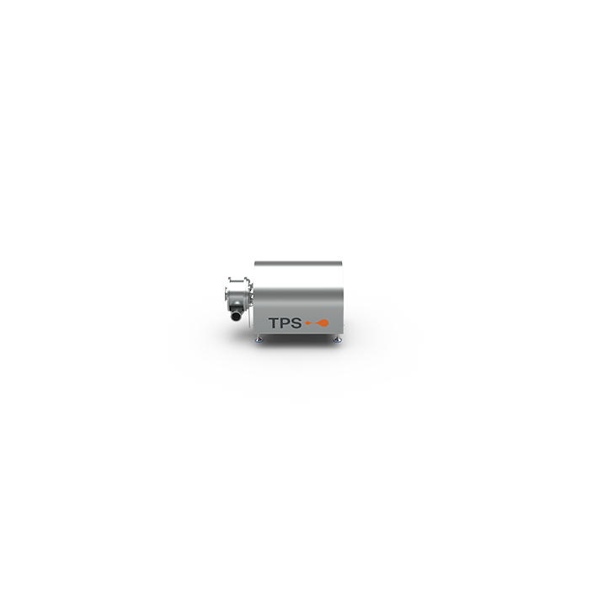
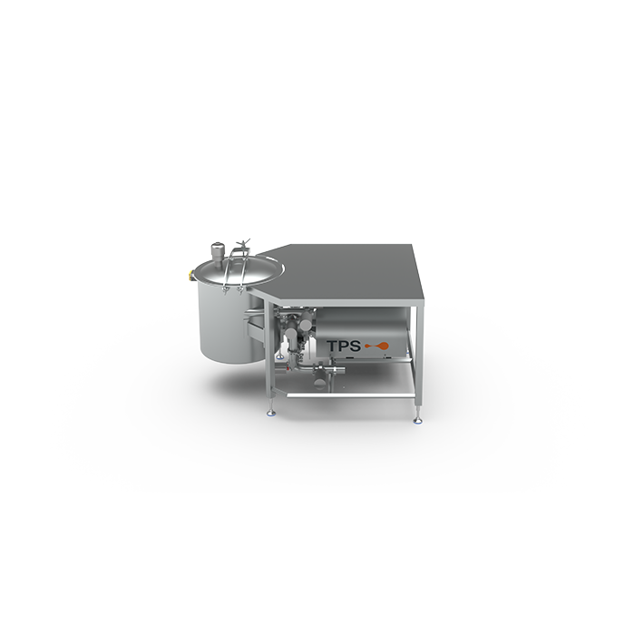
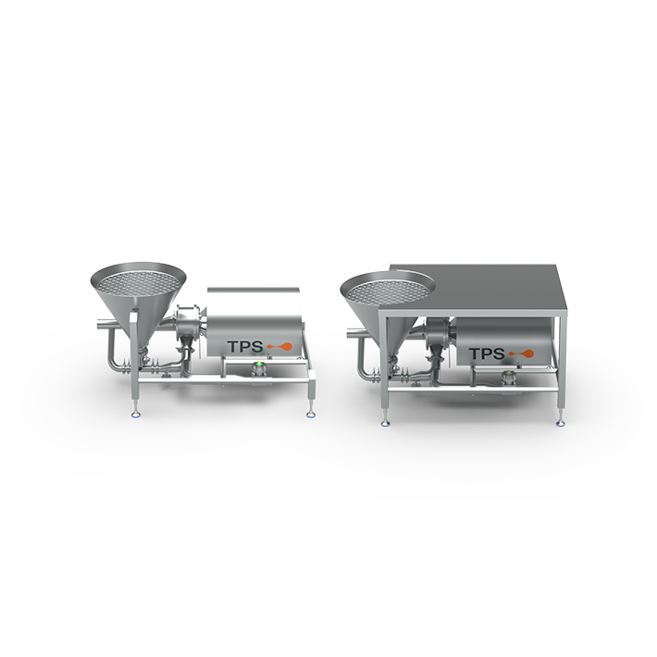
MixSing program range
 | Shear | Inject | Vortex | Standard | Vacuum | Process | Pilot

Slide 6
MixSing program advantages
 |  | TPS
Advantages | >200,000 in shear rate Particle size D(50) < 1.2 micron Noise < 78 dB(a) Independent corporation Workshop flexibility (fab/assembly) Technology & application key know-how Customization willingness | ✅ ✅ ✅ ✅ ✅ ✅ ✅

Slide 7
MixSing Shear
Use:
Batch: Multi-pass over a process vessel
Continues: Single-pass between process vessels.
Feeding pressure:
  Pumpable with centrifugal pump: self-suction
  Not pumpable with centrifugal pump: feed pump required
Flow:
< 300 m³/h
Applications:
  Mixing of powder and liquid ingredients
  Particle size reduction
  Removal of
Values:
  Cost effective, Low TCO, High OEE
  Homogenization to d_{0.5} > 1.5 µm
  Lump free

Slide 8
MixSing Injector
Use:
Batch: Multi-pass over a process vessel
Continues: Single-pass between process vessels.
Flow:
5 - 300 m³/h at 2 bar
Applications:
  Not exceeding X < 400 cP, higher viscosities based on tests
  Mixing of powder and liquid ingredients
  Suction of liquid ingredients into a process
Values:
  Cost effective, Low TCO, High OEE
  Funnel with injector system for controlled dosing of ingredients
  Homogenization to d_{0.5} < 1.5 µm
  Lump free

Slide 9
MixSing Vortex
Use:
Batch: Multi-pass over a process vessel
Continues: Single-pass between process vessels.
Flow:
20 – 300 m³/h at 2 bar
Applications:
  Not exceeding X < 400 cP, higher viscosities based on tests
  Mixing of powder and liquid ingredients
  Dosing of smaller soft particles
Values:
  Cost effective, Low TCO, High OEE
  Height adjustable table for bag placement
  Vessel with 75 liter
  Homogenization to d_{0.5} < 1.5 µm
  Lump free

Slide 10
MixSing Standard
Use:
Batch: Within process vessel
Continues: Feeding/emptying at constant flow
Multi-pass (In-line): Over multiple holding tanks
Applications:
  Not exceeding X < 1,500 cP, higher viscosities based on tests
  Mixing of powder and liquid ingredients
Values:
  Cost effective, Low TCO, High OEE
  Homogenization to d_{0.5} < 1.5 µm
  Lump free

Slide 11
MixSing Vacuum
Use:
Batch: Within process vessel
Continues: Feeding/emptying at constant flow
Multi-pass (In-line): Over multiple holding tanks
Applications:
  Not exceeding X < 1,500 cP, higher viscosities based on tests
  Mixing of powder and liquid ingredients
  Powder sucked into mix below liquid surface
Values:
  Cost effective, Low TCO, High OEE
  Homogenization to d_{0.5} < 1.5 µm
  Lump free
  Vacuum system for loading of ingredients, lower included air

Slide 12
MixSing Process
Use:
Batch: Within process vessel
Continues: Feeding/emptying at constant flow
Multi-pass (In-line): Over multiple holding tanks
Applications:
  Not exceeding X < 75,000 cP, higher viscosities based on tests
  Mixing of powder and liquid ingredients
  Mixing of larger particles
Values:
  Cost effective, Low TCO, High OEE
  Homogenization to d_{0.5} < 1.5 µm
  Lump free
  Jacket (cooling or heating medium)
  Direct steam injection for fast heating or cooking
  Vacuum system for loading of ingredients, lower included air
  Scrape agitator

